Slide 1
Capstone: Detecting Emotions in a Remote Work Era using Facial Emotion Detection
Khalis Kassim

Slide 2
Agenda
Problem Statement
Datasets
Data Cleaning & Merging
Challenges with Dataset
Considerations During Modelling
Data Augmentation
Custom Model
Transfer Learning
Results
Misclassification Analysis
Face Detection & Emotion Prediction
Testing on Web Camera
Real world Applications and Challenges
Conclusions & Further Improvements
Demo

Slide 3
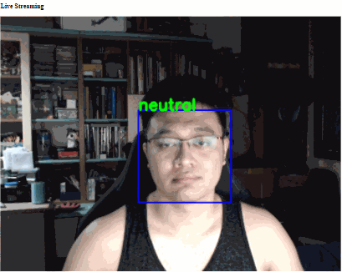

Slide 4
Problem Statement
Remote work has impacted most of us, positively and negatively, before and even more during these COVID-19 times. Reduction of socialising may have affected our ability to read body languages or actions during conversations. Additionally, everyone may have personal problems or issues in life outside of videos that we do not see or notice, but it may affect them in the work they do, or the changes in the facial expressions they exhibit.
Using facial detection, can we identify facial expressions and detect emotions?
Achieve and compare models based on best accuracy

Slide 5
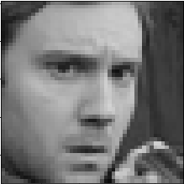
Datasets
FER2013 | FER+
7 emotion classes; Anger, Disgust, Fear, Happiness, Sadness, Surprise, Neutral | 7 + 3 additional classes; Contempt, Unknown, Not Found (NF)
1 emotion per image | Probability of 10 emotions per image
Pixel values of each image | Requires image data from FER2013
FER2013
FER+
Emotion | Probability Dist.
neutral | 4
happiness | 0
surprise | 0
sadness | 1
anger | 3
disgust | 2
contempt | 0
unknown | 0
NF | 0
Anger

Slide 6
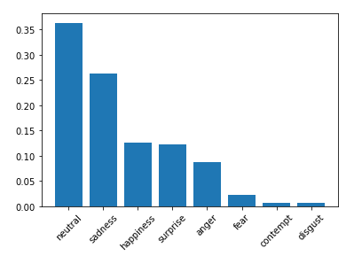
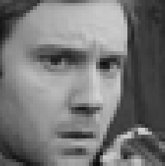
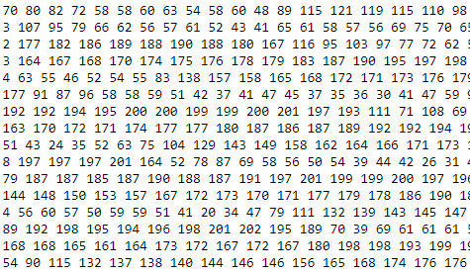
Data Cleaning & Merging
Merging both FER2013 and FER+ datasets
Take max of probability density from FER+ emotion classes as new emotion
173 records with Null ‘Image name’
399 records with with emotions tagged ‘NF’ or ‘Unknown’
Right skewed distribution of images
Exporting of Images
Stored as 48 * 48 pixel array
Conversion to png images; stored in classified emotion folders

Slide 7




















Challenges with Dataset
Grayscale has limitations
Reduced visibility of key facial features
Images have watermarks
Obscured facial features
Hands, Accessories
Cartoon images with emotions
Unknown or incorrectly classified training images
Is the guy happy, or angry?
Low Brightness
Watermarks
Obscured Features
Cartoon Images

Slide 8
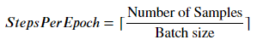
Considerations during Modelling
Data Augmentation
ImageDataGenerator
Allows real-time augmentation of training images
Fitting
Epochs
Batch Size specified in powers of 2 (32, 64, 128, 256); dependent on memory
Steps Per Epoch
Transfer Learning
Utilising pre-trained models

Slide 9









Data Augmentation
Brightness range
Increase or darkens pixel brightness to detect specific features
Rotation
Correction of images that are taken in a slanted manner
Shearing
Slanting and stretching images
Zoom
Zooming in/out on image by a factor
Channel Shift
Application of different colour channels to images
Not very useful for current dataset, but will be useful in highlighting features for coloured training data

Slide 10
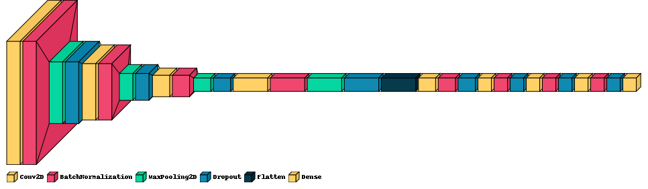
Custom Model
4 Convolutional Layers
4 Fully connected Dense layers
1 Output layer
Achieved 73.99% accuracy against validation set
Achieved 73.66% accuracy against unseen test set
1st Conv
2nd Conv
3rd Conv
4th Conv
Fully Connected Layers
Output layer of 8 classes

Slide 11
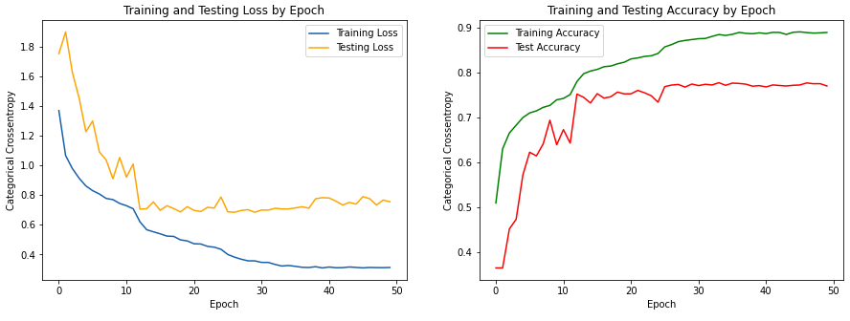
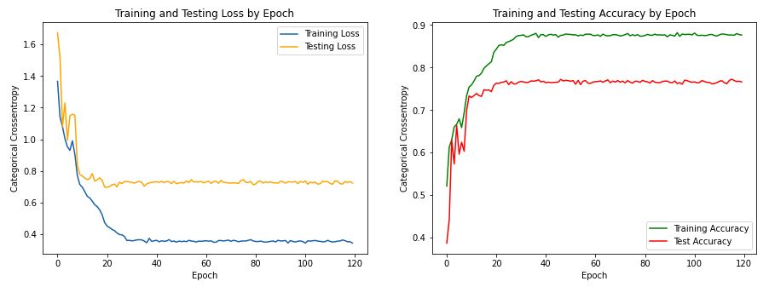
Results
Model | Validation Accuracy | Test (Unseen) Accuracy
Custom Model | 73.99% | 73.66%
VGG16 | 72.96% | 73.49%
VGG16 with Frozen Layers | 50.5% | 50.37%
Resnet50 | 77.76% | 78.62%
Resnet152 | 70.74% | 71.26%
Resnet50 with Additional Normalisation & Dropout | 77.57% | 78.37%
50 Epochs
120 Epochs

Slide 12
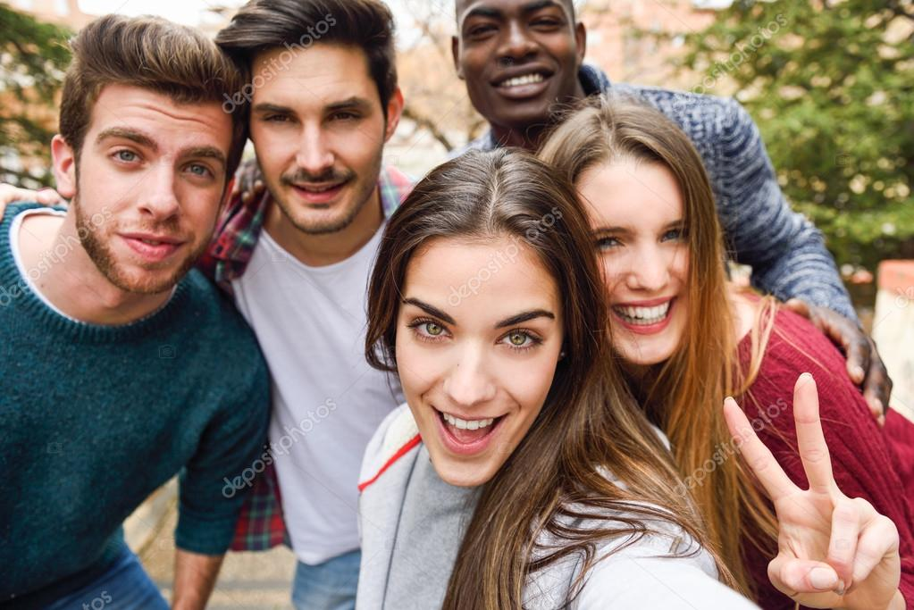
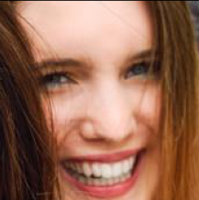
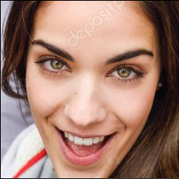
Face Detection and Emotion Prediction
In order to use the model on an application, we must first detect a face. Using OpenCV’s face detection Haar-Cascade classifiers:
Detect Faces in image/frame
model.predict(detected_face)
Display predicted emotion per detected face
happiness
neutral
happiness
happiness

Slide 13
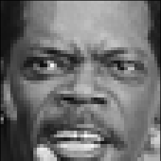
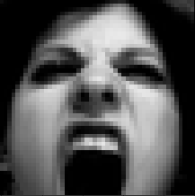
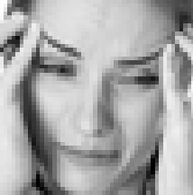
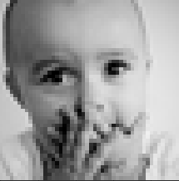
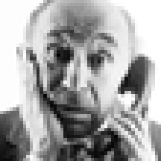
Misclassification Analysis
Anger, Happiness or Neutral are usually misclassified
Presence of teeth
Images with brighter pixels around mouth section
Pouts have no exposure of teeth
Obscured Facial Features contribute to misclassification
Hands or objects that cover key facial features

Slide 14
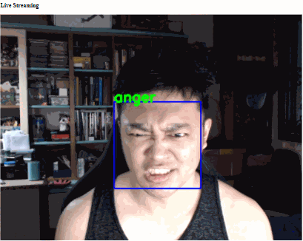
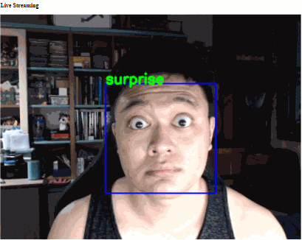
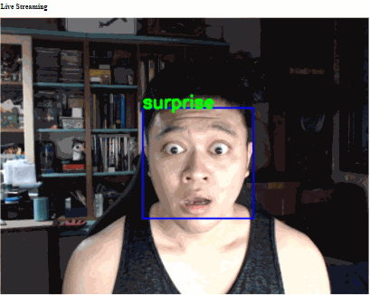
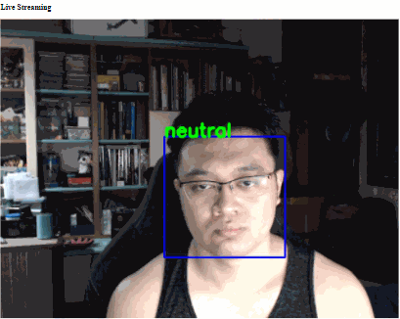
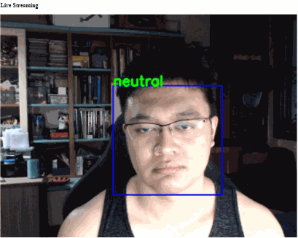
Testing on Web Camera
Anger and Happiness always have the presence of teeth
Surprise, Sadness and Fear both look the same in terms of features, except for the frown on forehead
Disgust and Contempt is challenging to replicate

Slide 15
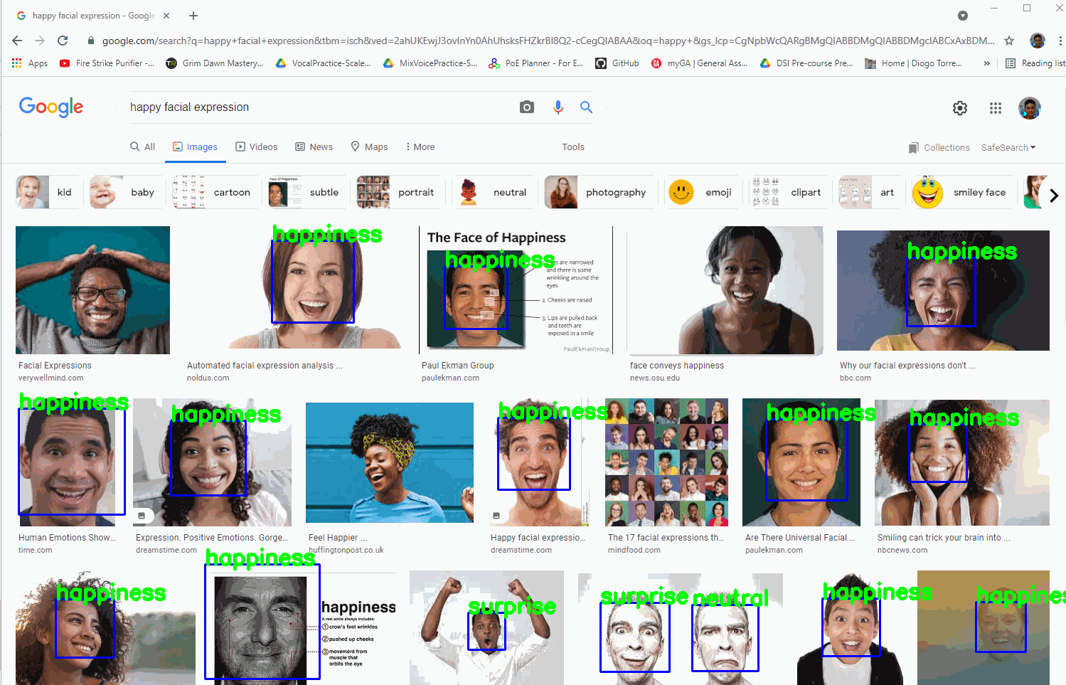
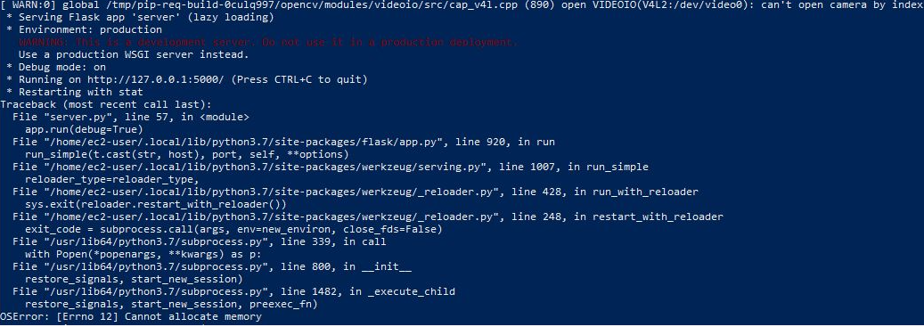
Real world Applications and Challenges
Types of usage:
Proctoring, Invigilation
General assessment of emotions
Web Camera, Screen Capture, accessing via Mobile devices
Computationally intensive and expensive
Good CPU/GPU
Detect Face > Predict Emotions > Return Results
Extremely expensive to process asynchronous facial detection in real-time via web applications

Slide 16
Conclusions & Further Improvements
Improvements on training dataset
Coloured facial emotions
Pictures without watermarks
More training data
Extended Cohn-Kanade (CK+)
Japanese Female Facial Expression (JAFFE)
Further exploration specific to facial features
Eyes, mouth, forehead, etc
Google Face
Larger sized training sets
Better and sharper defined features
Improvements on Emotion Detection
Combining Speech Recognition to detect tonal changes
Faces might not always be shown in video calls
Tonal changes in conjunction with facial detection can make better predictions

Slide 17
Demo

Slide 18
The End

